Slide 1
Traversing a List
A supplemental lesson for AP CSP

Slide 2
Warm-up
In the previous lesson, you accessed elements in a list by using the index.
Review the code from the PythonLists1 program.
How did you access an element in the first function?
How did you access an element in the second function?
What change did you make for the third function?

Slide 3
Introduction
In the previous lesson, you accessed a single element in a list by using the index. But sometimes you want to access every element in a list – in order.
This is called “traversing.”
It means to travel, or traverse, through a list one element at a time in order.
Start with the first index (0) and continue until the last index (length of list - 1).

Slide 4
Introduction
Traversing a list can be very useful in many ways:
Display all items in a list
Sounding all beeps one at a time, in order
Go through a specific pattern of LED lights
Other reasons (to be explored later):
See if a specific item is in a list
Create a sub-list from the complete list

Slide 5
Traversing a List: Example #1
Open the PythonLists1 program
Use the sandbox.
Do a Save As and called the new program PythonLists2
You will add another list to the program.
You will add more functions to the program.

Slide 6
Traversing a List: Example #1
The easiest, most efficient way to traverse a list is to use a for loop.
The range of the loop is usually 0 (first index) and goes through the last index (length of list - 1).
That means the range of the iteration is len(list).
Define a new function in your program that will traverse the list of beeps.

Slide 7
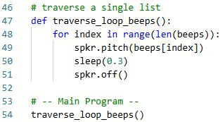
Traversing a List: Example #1
The loop automatically starts at 0.
The loop goes up to but does not include the range, so len(beeps) is perfect.

Slide 8
Traversing a List: Example #1
One way the list manages complexity is by using len(beeps) in the range.
If the list is modified – elements are added or removed – the code doesn’t need to be changed.
It will automatically traverse the list of any size.

Slide 9
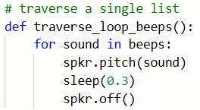
Traversing a List: Example #1
But since this is done so regularly, there is an even faster way to traverse a single list.
This structure builds in accessing the element by index.
Modify your function to use the new structure:

Slide 10
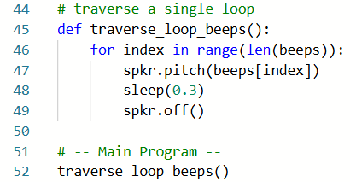
Traversing a List: Example #1
Compare the two loops:
The list
The “counter” or “index” variable can be any name, but the more descriptive the better.
It holds the value of an item from the list.

Slide 11
Traversing a List: Example #2
Let’s add another list to the program.
What types of elements can be in a list?
In CheckLines, the detect list contained Boolean values (True or False).
In LineFollow1, the sensors list contained integers.
Lists can also contain strings, and any other data you use in a program.
Lists can even contain binary values, like the ones used to control LEDs.

Slide 12
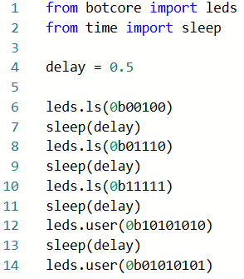
Traversing a List: Example #2
In Mission 3, the program BinaryLEDs used binary numbers to control user LEDs and line sensor LEDs.
Open the program.
Review the code.

Slide 13
Traversing a List: Example #2
Return to PythonLists2
Define another list for this program.
The elements of the list will be binary numbers to control the user LEDs.
The binary numbers will be patterns you want to display a light show using the the user LEDs.

Slide 14

Traversing a List: Example #2
You decide how many patterns (elements) you want in your list.
You decide the patterns and their order.
A suggestion is given below.
The list is broken into two lines so it is readable on the screen.

Slide 15
Traversing a List: Example #2
Define another function in your program that traverses the patterns list.
Try doing this function on your own.

Slide 16
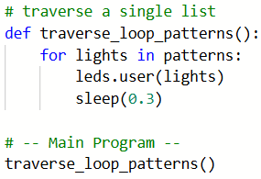
Traversing a List: Example #2
Run the code.
You should see the LEDs light up using the patterns, in order.

Slide 17
Traversing a List: Example #3
What if you want the beeps and the user LEDs going at the same time?
Of course, you can do this!
But, a specialized for loop will not work.
Use a regular for loop with an index as the counter.
Then the index can be used to reference an element in both lists.

Slide 18
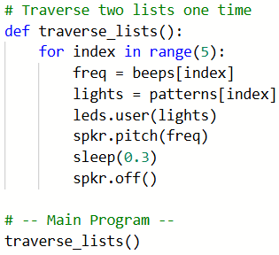
Traversing a List: Example #3
Just to get started, make the for loop go only 5 times.
Make sure you have at least 5 elements in each loop.

Slide 19
Traversing a List: Example #3
That works pretty good.
But my lists are longer than 5 elements.
Are your lists longer than 5 elements?
If not, take some time now to add elements to your lists.
They do not need to be the same length, but they each should have more than 5 elements.

Slide 20
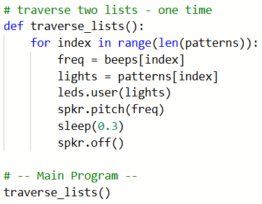
Traversing a List: Example #3
Modify the for loop to traverse the shorter list.
If the beeps list is shorter, use len(beeps).
If the patterns list is shorter, use len(patterns).
If they are the same length, you can use either one.

Slide 21
Traversing a List: Example #4
That works better.
But in my example I used all the patterns but not all the beeps. And I might want to repeat the patterns and/or beeps for a longer period of time.
Let’s give it a try!
Define another function.
Copy and paste the code in traverse_lists() into the new function.

Slide 22
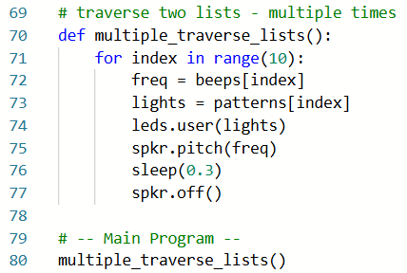
Traversing a List: Example #4
Change the for loop range to a number larger than your list lengths.

Slide 23
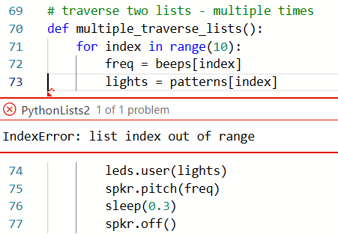
Traversing a List: Example #4
Uh oh! – an error message!
The value of the for loop index becomes greater than the actual list index.

Slide 24
Traversing a List: Example #4
This is a great time to use modulo division!
Remember – modulo division can limit the possible values.
x % 5 : possible values are 0, 1, 2, 3, 4
x % 9 : possible values are 0 to 8
You can use modulo division for both lists so the index does not exceed the number of elements.
Use the len() of each list as the divisor.

Slide 25
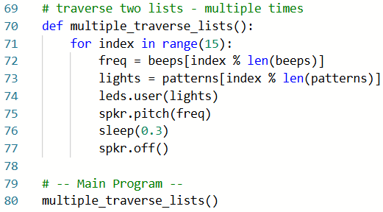
Traversing a List: Example #4
Run the code.
You should see the LED light show and beeps for the number of times you selected.
You can even change the range to any number (even a random one) – you are managing complexity!

Slide 26
Traversing a List: Challenge
You now have several ways to traverse a list in a CodeBot program:
Traverse a single list
Traverse multiple lists
Repeatedly traverse multiple lists
Use this program as your own personal library. When you need to use a list, access an element, or traverse a list, you can refer to this code, if needed.

Slide 27
Traversing a List: Challenge
Traversing a list can be used with the CodeBot, even in a program you already completed. Give it a try!
Open the LineSense program from Mission 5.
Define (create) a list of beeps.
Define (create) a list of patterns.
You can use the same ones from PythonLists2 if you want.

Slide 28
Traversing a List: Challenge
Currently the back_turn() function uses a sleep delay while the motors are backing up and turning.
You can make it more interesting by putting on a flashing lights show instead of sleep().
Create another function for light_show().
Traverse the patterns list in the function, and get a random beep each time a new pattern is displayed.

Slide 29
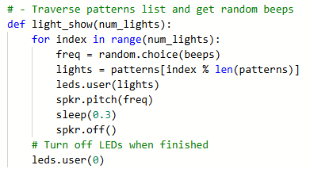
Traversing a List: Challenge
The range of the for loop can be passed as a parameter to the function. It will be the sleep delay.
Your function should look similar to this:

Slide 30
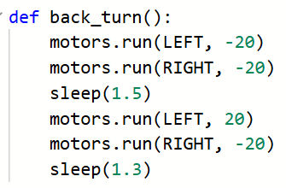
Traversing a List: Challenge
Call the light_show() function in back_turns().
Replace the sleep() function with light_show().
Use the amount of delay in sleep as the argument for light_show()

Slide 31
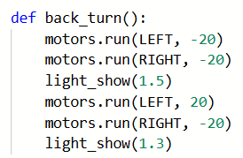
Traversing a List: Challenge
Run the code. You can just hold the CodeBot and put a finger under a line sensor to initiate a turn.

Slide 32
Traversing a List: Challenge
Does it work the way you expected?
The argument for light_show() represents the time delay, not the number of lights.
The actual number of lights in the light show should be different than the sleep() delay
Also, the light_show() function still has a sleep() in it that needs to be accounted for.
Let’s add another parameter and do some math.

Slide 33
Traversing a List: Challenge
Add another parameter for the sleep delay.
This second parameter will enable the lights and beeps when moving backward to be a different speed than when turning. Cool!
Functions and parameters can help you do this – manage complexity! Same function with different lights and delays.
Use this delay value to determine the actual number of light patterns needed.

Slide 34
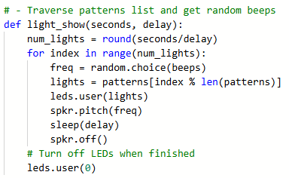
Traversing a List: Challenge
Change the first parameter to be descriptive: seconds
Add a second parameter to the function: delay.
Use the delay variable in the code.
Use some math to calculate the number of lights.

Slide 35
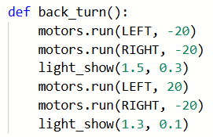
Traversing a List: Challenge
Add a second argument to the function calls. This will be the amount of delay in the light show. You can vary the delay and see what happens.
Run the code.
Your program should work like it did before, but with a light show every time it detects a line.

Slide 36
Wrap Up
Submit the PythonLists2 program and the modified LineSense program to your teacher.
Complete the wrap-up questions in the assignment.

